Slide 1

Boosting Business in Banking: Harnessing Machine Learning to Solve Customer Churn
Created by : Pompy Mandislian

Slide 2

Outline
Background Project
Datasheet
Architecture
Exploratory Data Analysis
Modeling Recognition
Evaluation Model
Deployment Process

Slide 3


Introduction
at the bank several times lost several customers and experienced a decrease in profits. The company does not yet know how customers who have subscribed for a long time can be churn. Data has been collected for the find out find churn method. but the company has not found the root cause, therefore the company asked the data science team to make predictions with machine learning.

Slide 4
UNDERSTANDING THE PROBLEM
Sub-Problem
Main-Problem
What is obtained after conducting the analysis?
Which model is the best choice?
Which is columns that most affects?
How to solve the problem churn in the bank?

Slide 5
PROBLEM OUR GOALS
Make a model that is effective and can be used for predictions.
Create an interface that can be used by the user
Reduce customer churn thereby increasing the company's income

Slide 6
Datasheet
Data input:
Age : Age of Umur Customer. credit_score : Score how well a person pays debts Country : Place of customer country. Gender : Male or Female. Tenure : level of security or stability in work. Balance : Income each months from customers. Credit_card : Have a creadit or not.
Active_member : Have a active member in bank or not.
Estimated_Salary : Estimation income from customers.
Output/Target :
Churn : Customers who are make churn

Slide 7

ARCHITECTURE

Slide 8
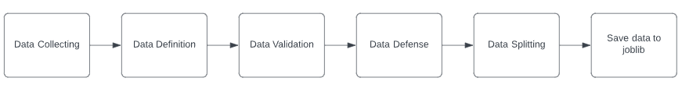
ARCHITECTURE – DATA PREAPERATION

Slide 9
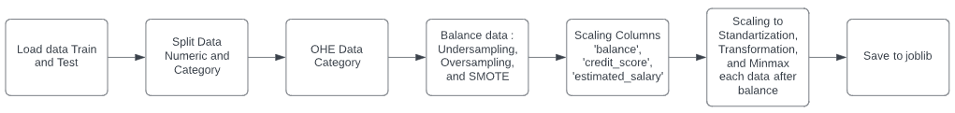
ARCHITECTURE – FEAUTURE ENGINEERING/PREPROCESSING

Slide 10
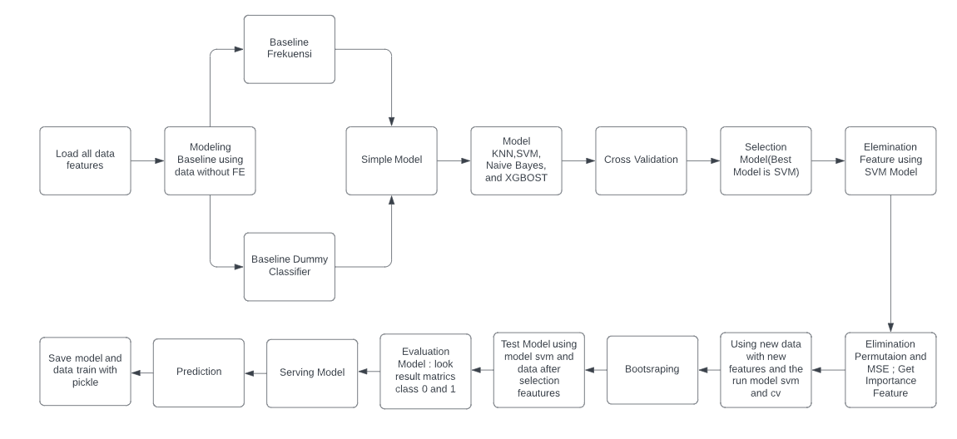
ARCHITECTURE – MODELING

Slide 11
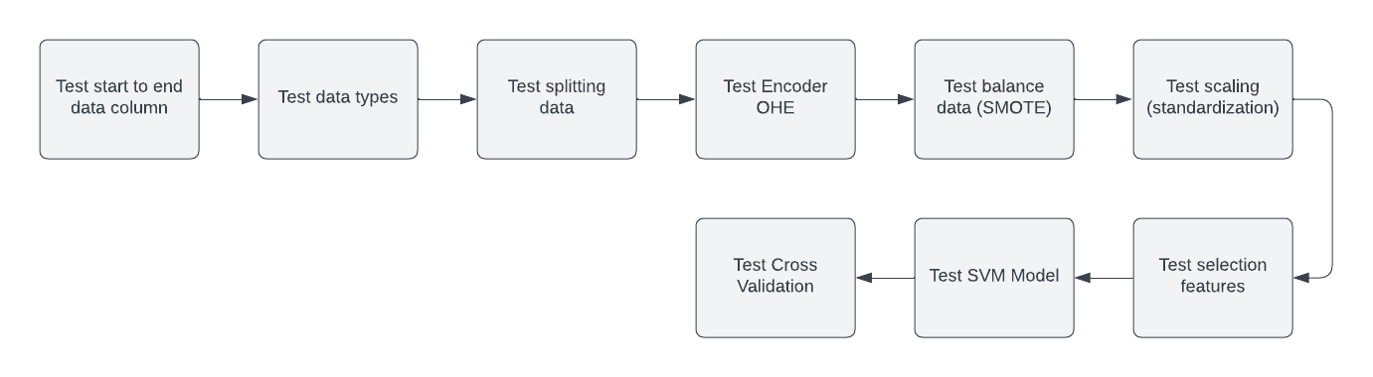
ARCHITECTURE – PYTEST

Slide 12
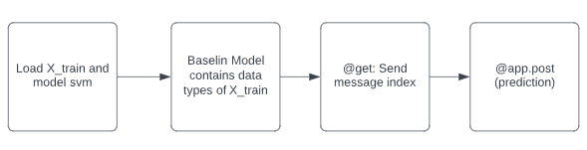
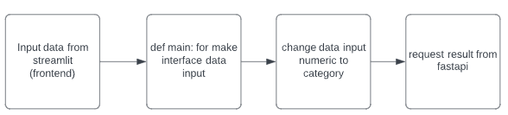
ARCHITECTURE – FASTAPI AND STREAMLIT
FastApi :
Streamlit :

Slide 13

EXSPLORATORY DATA ANALYSIS

Slide 14
Insight
What is obtained after conducting the analysis?
Statistik Deskriptif
1. Churn have rerate balance >= unchurn ($120978 >= $119749)
2. Churn have rerate credit score <= unchurn (646 <= 651)
3. Churn have rerate estimated salary >= unchurn ($102193 >= $100664)
4. Min columns balance, credit score, and estimated salary of churn <= unchurn
Data Visualization
1. The country column of churn and unchurn the highest is Germany
2. The gender column of churn and unchurn the highest is Male
3. The age column of churn and unchurn the highest is Mature and very significant
4. The credit card column of churn and unchurn the highest is have not credit card
5. The active member column of churn and unchurn the highest is have not active member

Slide 15
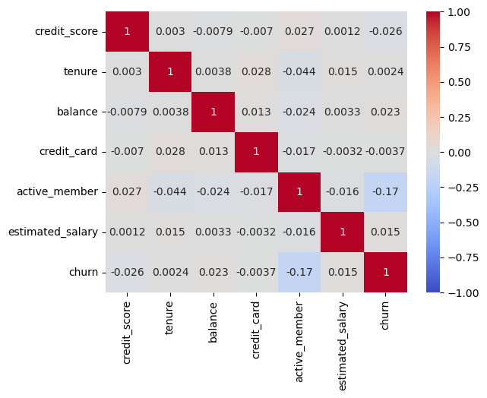
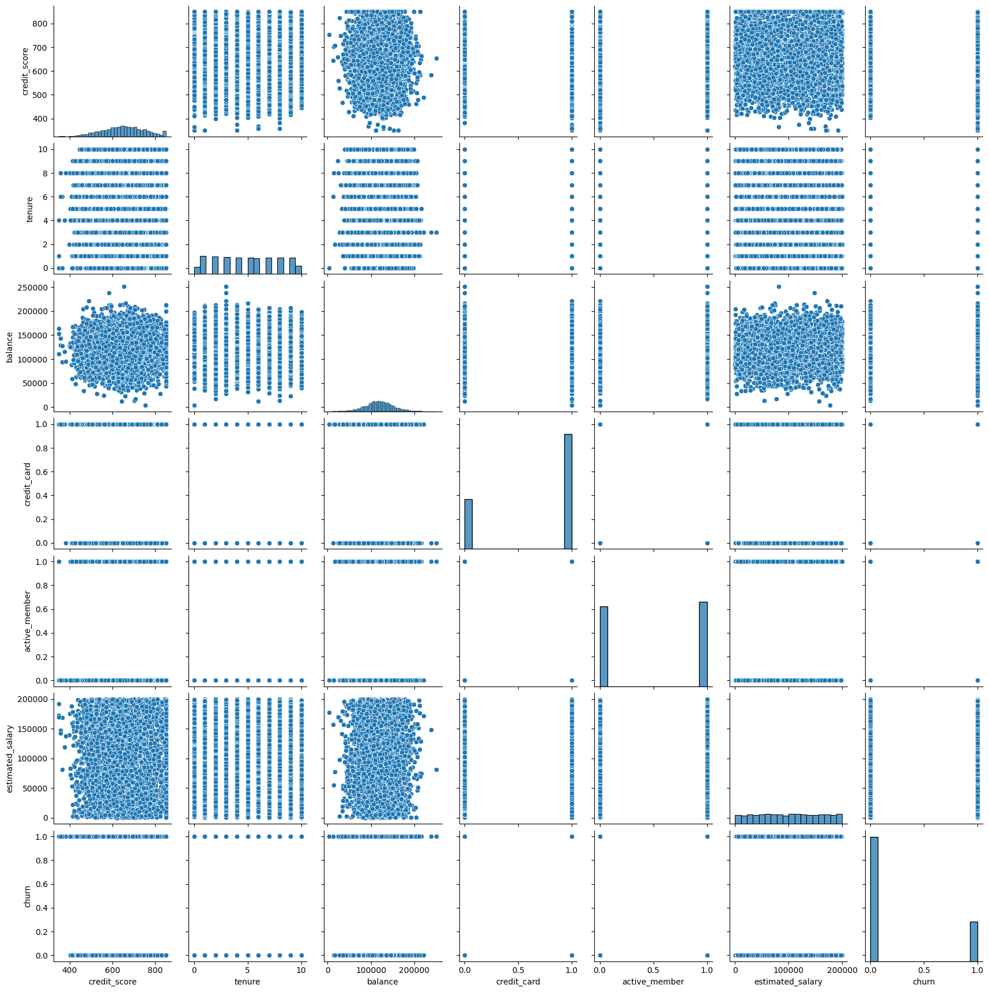
Insight

Slide 16
Insight
What is obtained after conducting the analysis?
Correlation
1. Base on correlation data numeric and category the result of correlation is very low <=0.001
2. Base on correlation data category and category the result of correlation Pearson Chi-square is the columns of Age and Country have high correlation
3. Base on correlation data numeric and numeric the result of correlation is very low <=0.001
4. The correlation look with pairplot, we obtain that correlation is not linear.

Slide 17

How to Model Work

Slide 18
How The Baseline Model Works
Baseline model frequency (Accuracy).
Sum of class 0 divide with total data
Sum of class 1 divide with total data
Baseline model DummyClassifier.
Prediction at random without consideration features data.

Slide 19
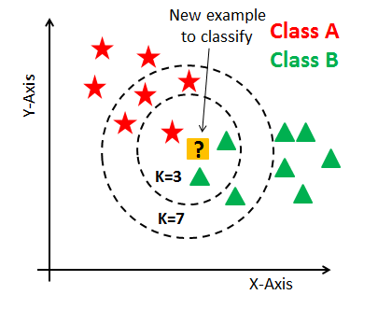
How The KNN Model Works
This model works based on nearest neighbors.
K values to determine the number of nearest neighbors.
The prediction results are based on the class of the majority of its closest neighbors.
My model = KNeighborsClassifier(n_neighbors=n_3,weights='uniform')

Slide 20
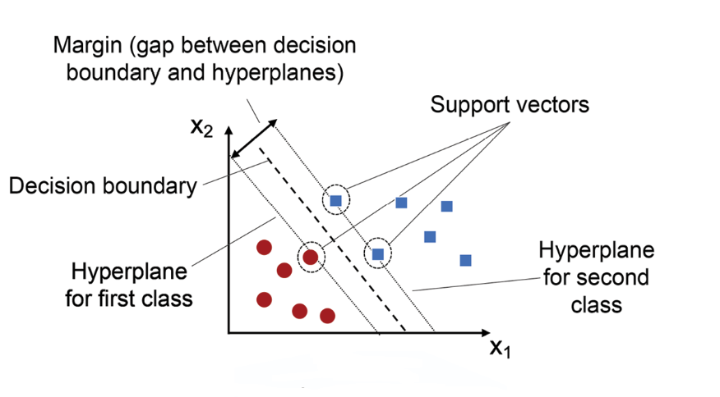
How The SVM Model Works
Create a boundary between class 0 and 1 using margin.
Boundary base on support vectors each class.
Separation using a linear transformation if can not then using non linear transformation.
My model = SVC(C = 90, gamma='auto')

Slide 21
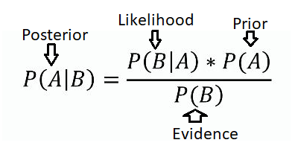
How The Bayesian Model Works
The model work based on the posterior results, if threshold > 0.5 then result is 1 else 0.
Likelihood estimate conditional probabilities on input features.
The calculation of each input is calculated independently and then normalized to get a threshold value.
My model = GaussianNB(var_smoothing = 1e-9)

Slide 22
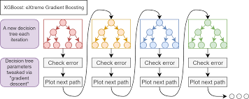
How The Xgbost Model Works
The model is ensemble using many desicion tree for prediction.
As a result of each iteration of the decision tree model, the model will make improvements based on the weight values for decrases residual.
My model = XGBClassifier(n_estimators = 25, max_bin = 5, booster='gbtree', max_depth = 5)

Slide 23
MODEL RESULTS

Slide 24
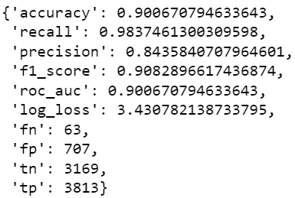
KNN Model
Results of the data train metrics:
Cross Validation :

Slide 25
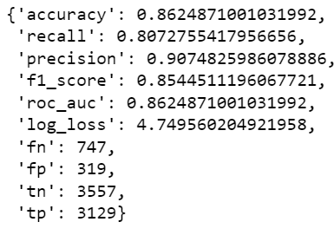
SVM Model
Results of the data train metrics:
Cross Validation :

Slide 26
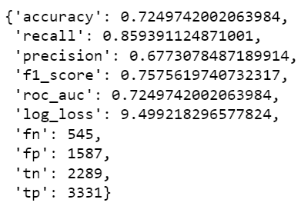
Bayesian Model
Results of the data train metrics:
Cross Validation :

Slide 27
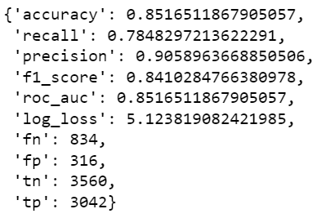
Xgbost Model
Results of the data train metrics:
Cross Validation :

Slide 28
SELECTION MODEL

Slide 29
BEST MODEL:
Model | Data Train | CrossValidation
Baseline Freq | 0.75 | -
Baseline DummyClassifier | 0.63 | -
KNN | 0.90 | 0.77
SVM | 0.86 | 0.82
Bayesian | 0.72 | 0.73
Xgbost | 0.85 | 0.66
Best model is SVM because model not far overfitting

Slide 30
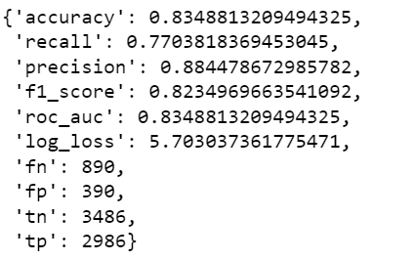
Features Selection: Permutation Methods
selected_feature_names = [['gender_Male', 'country_France', 'Age_young', 'gender_Female',
'country_Spain', 'country_Germany', 'Age_mature', 'active_member','tenure', 'balance','credit_score',]]
Results of the data train metrics:
Cross Validation :
Bootsrap of Model Train:

Slide 31
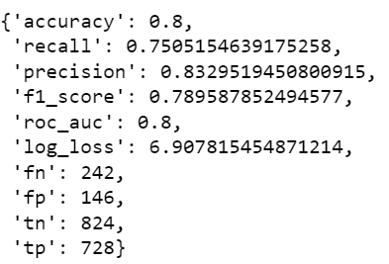
Data Test:
Choose features from permutation result:
Results of the data test metrics:

Slide 32
Evaluation Model :
Choose features from permutation result:
Recall Positive | Recall Negative | precision_ positive | precision_ negative | f1_score_ positive | f1_score_ negative
0.75 | 0.84 | 0.83 | 0.77 | 0.78 | 0.80
Class Negative is Churn
Class Positive is Unchurn

Slide 33
DEPLOYMENT PROCESS

Slide 34
Pytest :
Test Columns :
Start and end columns is correct
- credit_score - Start
- Age – End
Test Dtypes is correct, Contains :
- 2 float dtypes
- 5 int dtypes
- 7 object dtypes
Test Split data is correct:
X_train = 9 columns
X_test = 9 columns

Slide 35
Pytest :
Test Preprocessing :
Test Encoder OHE is correct :
- X_train = 14 columns
- X_test = 14 columns
Test Balance data with SMOTE method is correct :
Test standardization data is correct

Slide 36
Pytest :
Test Model :
Test Model Data Train :
All metrics decrase as big as 1 percentage .
Test Cross Validation :
Accuracy metric decrease as big as 1 percentage.

Slide 37
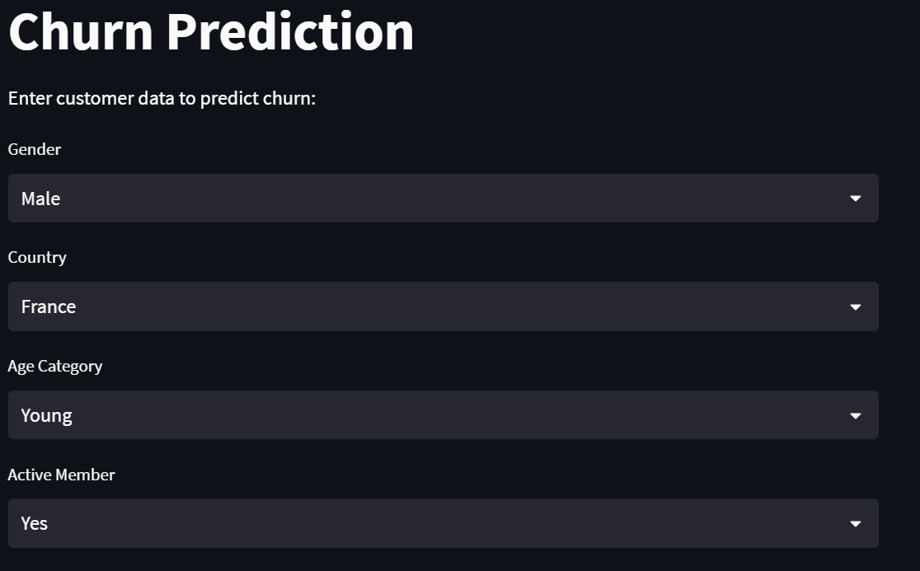
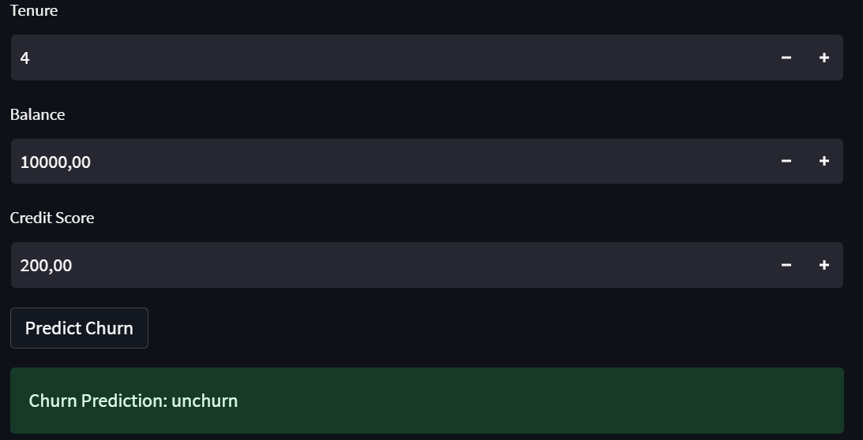
FastAPI And Streamlit:
Streamlit as Frontend :
# Make POST request to FastAPI server
try:
response = requests.post("http://localhost:8000/prediction", json=data)
response.raise_for_status() # Raises an exception for 4xx or 5xx status codes
result = response.json()
prediction = result["prediction is"]
st.success(f"Churn Prediction: {prediction}")
except requests.exceptions.RequestException as e:
st.error(f"Failed to make prediction. Error: {e}")

Slide 38
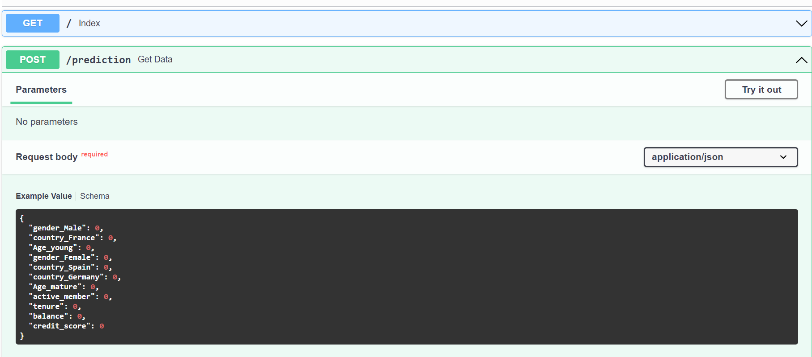
FastAPI And Streamlit:
FastAPI as Frontend :

Slide 39
Docker:
How to Run Model in Localhost - Docker
Import/built file Streamlit and FastAPI to Docker Image >> docker built -t (name image) .
Run Container Streamlit and FastAPI >> docker run -p (name images in docker).
Stop Image and container streamlit and FastAPI in the docker.
Compose file docker compose >> docker compose up
Run docker compose in new images (fill streamlit and fastapi)
Input data in the streamlit

Slide 40

INSIGHT BUSINESS

Slide 41
INSIGHT BUSINESS FROM MODEL:
With a recall of 0.75 for the positive class (churn) and 0.84 for the negative class (unchurn), the model is capable of recognizing a significant portion of churn-risk customers as well as customers who are likely to remain loyal.
With a precision of 0.83 for the positive class and 0.77 for the negative class, the model provides accurate and reliable predictions regarding customers who truly churn and those who remain unchurned. This enables businesses to take appropriate preventive actions for at-risk churn customers and focus their retention efforts on customers who are likely to remain loyal.
With F1-scores of 0.78 for the positive class and 0.80 for the negative class, the model exhibits a good balance between precision and recall. This provides valuable insights for businesses in formulating effective customer retention strategies, optimizing resource utilization, and enhancing overall customer satisfaction.

Slide 42
REFERENSI
Pacmann Class
Book : Approaching (Almost) Any Machine Learning Problem
Book : Introduction to Statistical Learning 2nd Edition
Youtube
Other Paper

Slide 43


